Slide 1
Analysis of the utilization of nodes and tools to maximize it
30th January 2025
Varshini Giri
Project Review - 1

Slide 2
Objectives
To improve the discipline and productivity among the Team.


Node Utilization
Error Correlation
To understand the various test run on a particular Node and plot a graph that gives the details about when and what test have run classified by the firmware and cluster data
To increase the efficiency of debugging an error caused by a same cause. Group all the similar errors and mail the person owning mostly of the errors


Time prediction
Make a Dashboard
Given a test plan, we need to predict the duration for executing all the test scripts and also help optimize the number of nodes needed.
Make an interactive dashboard to display all the information to the customers and look for improvements

Slide 3
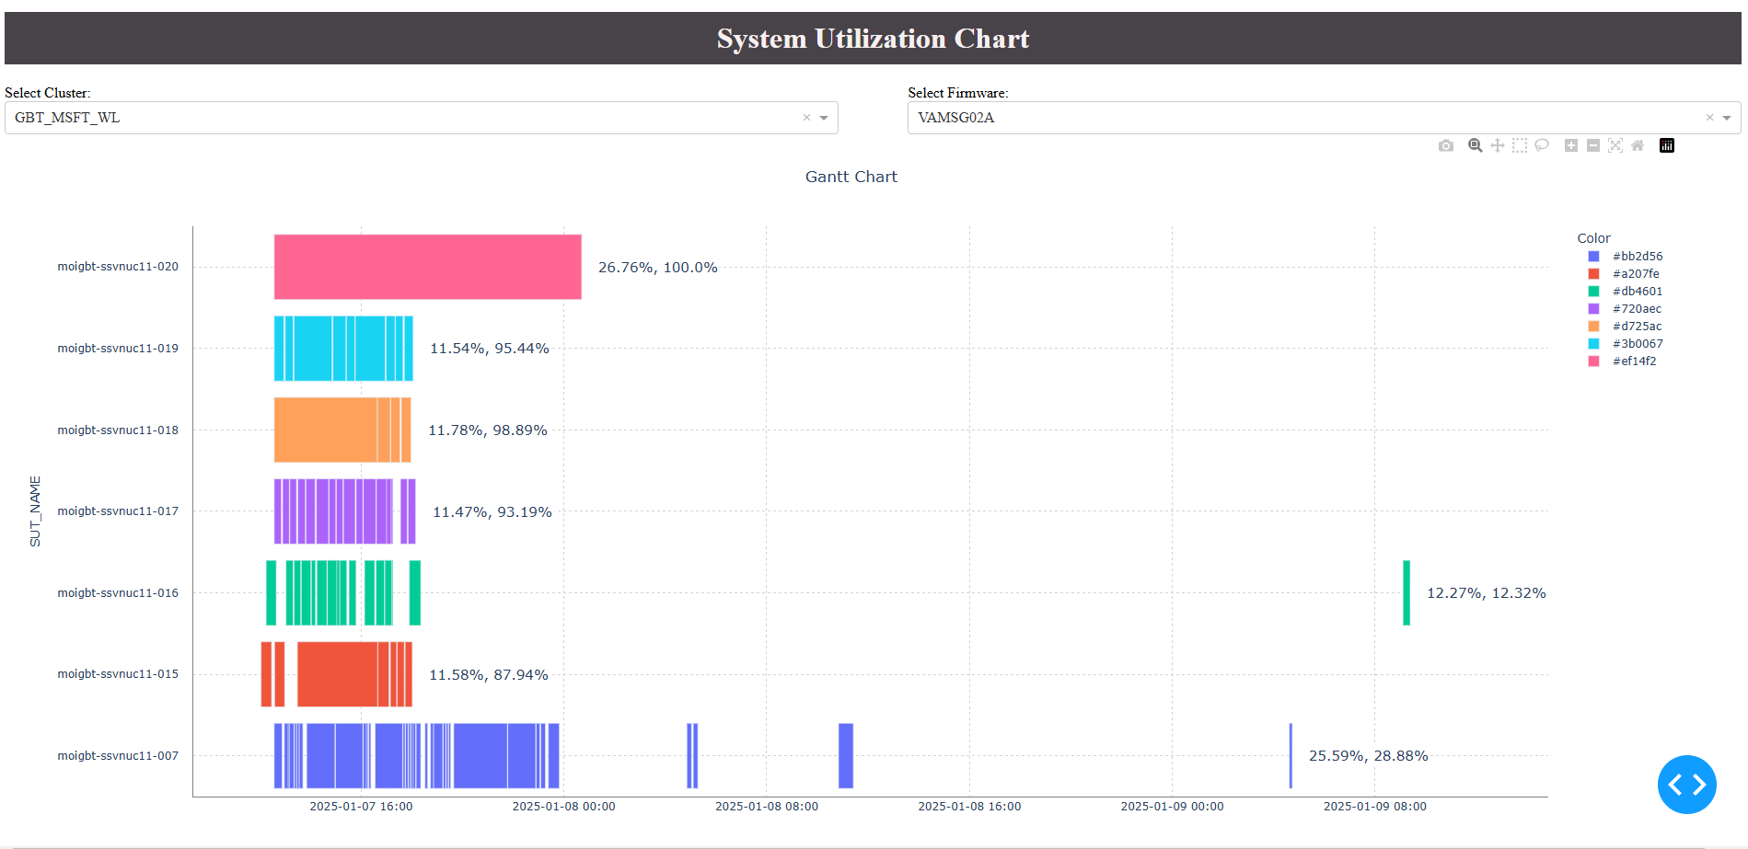
Node Utilization - Dashboard
Dashboard using Dash and Plotly libraries in python
Used REST API to retrieve data from the MTAP portal.
Traverse through all 6 months data from the System history and divide them according to firmware
Plot the data using a Gantt chart and visualize the drawback and area of improvements
Given options to choose Cluster and Firmware for the ease of the user
Data source: MTAP ( system history ), Cluster tree

Slide 4
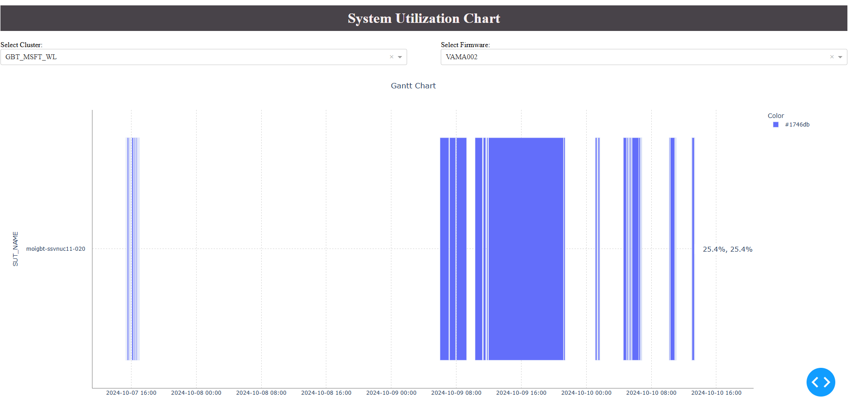
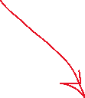
Node Utilization - Dashboard
Scope for improvement
Why are there gaps in between the tests that are run for the same firmware?
Provision to plot node by node to have closer look into the utilization

Slide 5
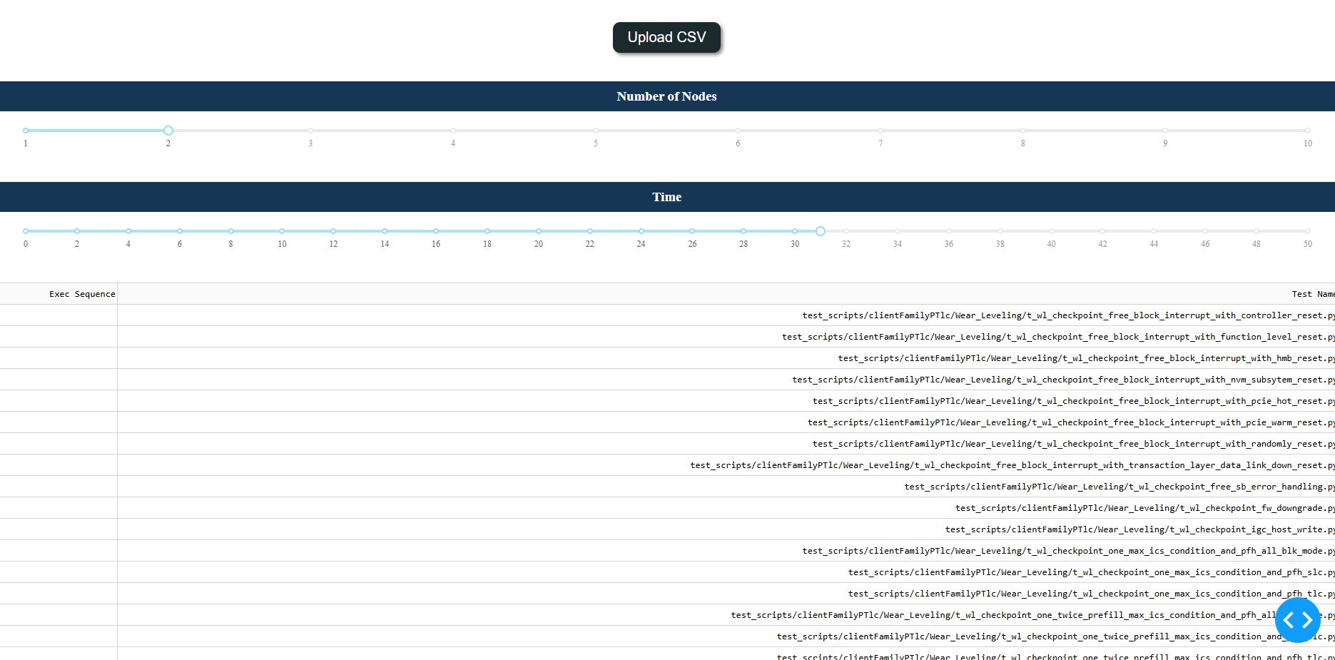
Time and Node Prediction
To have a pre-knowledge and efficient scheduling of Tests
Contains a slider to adjust the time and nodes accordingly
Uses Longest-processing time first (LPTF) algorithm for finding the efficient distribution of tests
Also displays the script names
We can upload any CSV file containing a test plan to predict the allocation and time
Self-updates
Data source: MTAP script history – to collect the avg time
Considers weighted average time

Slide 6
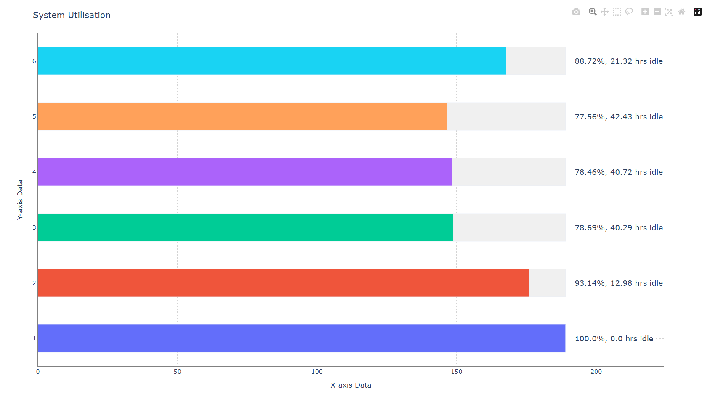

Slide 7
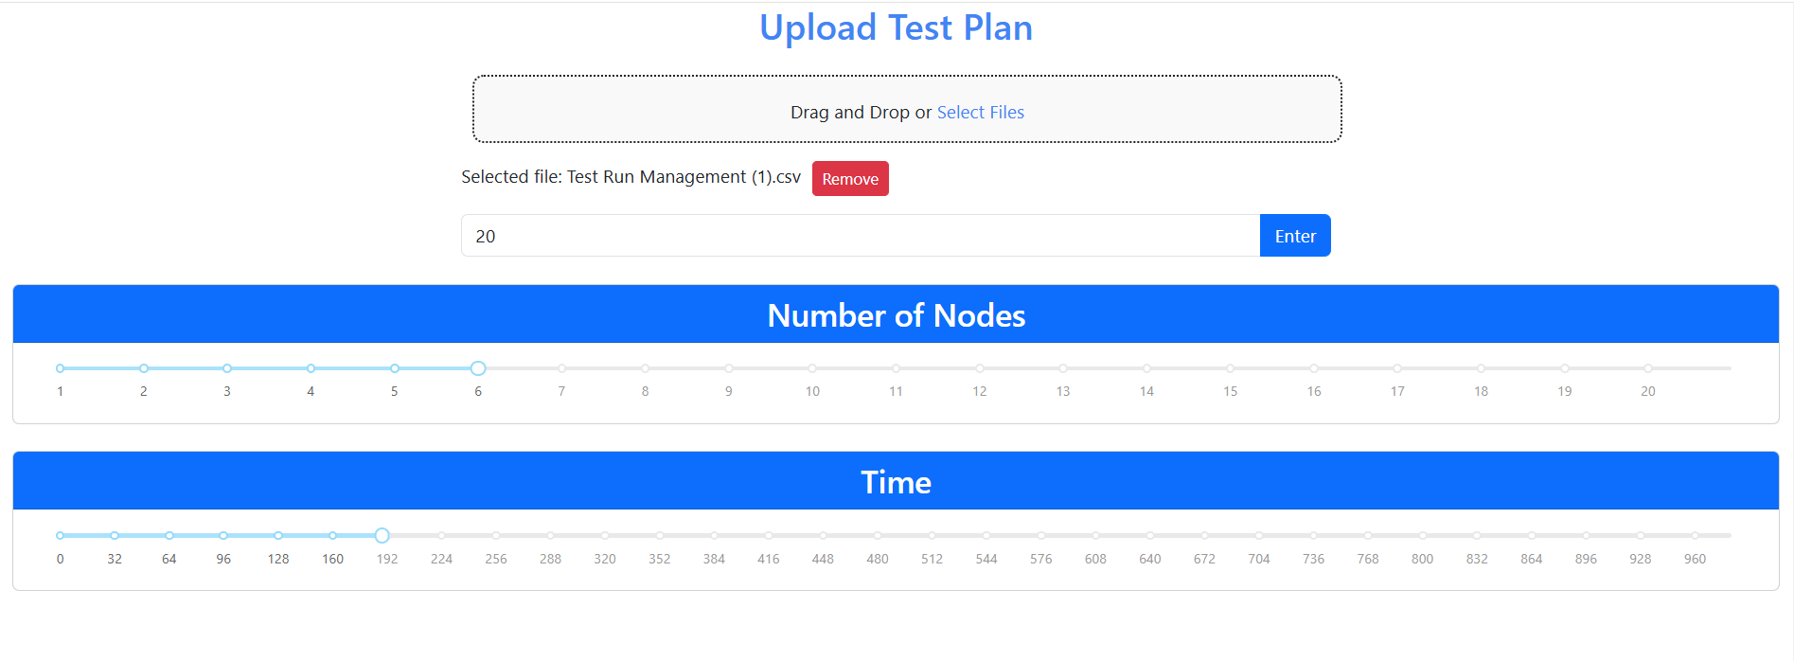

Slide 8
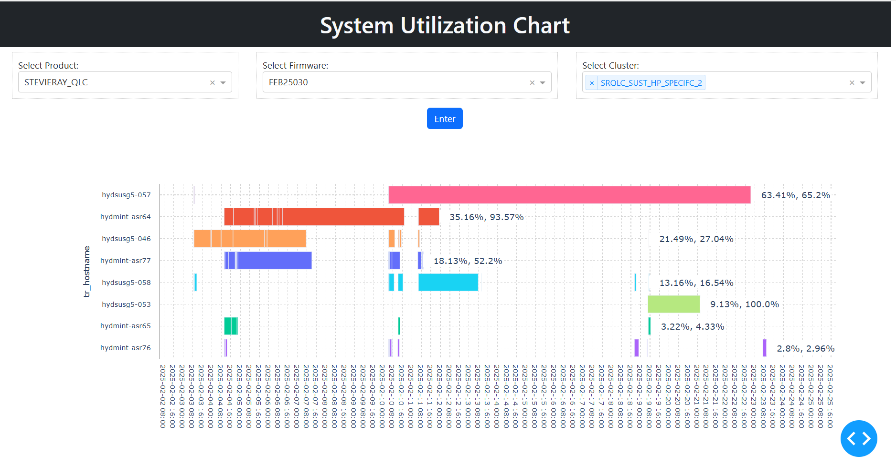

Slide 9





Time and Node Prediction
Further works – Add more features
Time Left
ARRANGMENT
Make interactive set up where is shows much time is left for each node – idle state
Provide details about which tests comes under a particular nodes – color code or number codes
Common improvement
The code is generally slow due to API calls and various calculations sequentially.
Try using the DATABASE records from backend
Try parallel processing
Flexibility
UI - IMPROV
Allowing the user to change the allocation of the scripts to the nodes and edit the same
Improve the UI of the dashboards – make it user friendly

Slide 10
READ & DELETE BEFORE USING
If needed, update the legal notice on the end slide using View > Slide Master. When done, View > Normal.
Both the “End Slide” and “End Slide – Dark Mode” slide masters should be updated consistently.

